Slide 1
Physics
for
computer science

Slide 2
Chapter (1): Physics and Measurements Chapter (2) : Vectors Chapter (3) : Kinematics Chapter (4) : Dynamics Chapter (5) : Circular and Rotational Motion Chapter (6) : Oscillations Chapter (7) : Wave Motion Chapter (8) : Magnetism
(General Physics)

Slide 3
Physical Quantity
A quantity which is measurable is called ‘physical quantity’.
1- Fundamental Quantity
A physical quantity which is the base and can not be derived from any other quantity is called ‘fundamental quantity’.
Examples: Length, Mass, Time, etc.
2- Derived Quantity
A physical quantity which can be derived or expressed from base or fundamental quantity / quantities is called ‘derived quantity’.
Examples: Speed, velocity, acceleration, force, momentum, torque, energy, pressure, density, thermal conductivity, resistance, magnetic moment, etc.

Slide 4
Unit
Measurement of any physical quantity involves comparison with a certain basic, arbitrarily chosen, internationally accepted reference standard called unit.
1- Fundamental Units
The units of the fundamental or base quantities are called fundamental or base units.
Examples: metre, kilogramme, second, etc.
2- Derived Units
The units of the derived quantities which can be expressed from the base or fundamental quantities are called derived units.
Examples: metre/sec, kg/m³, kg m/s², kg m²/s², etc.

Slide 5
Measurements systems
Quantity | Dimension | System of units
 |  | fps | cgs | mks
Length | L | foot | centi metre | metre
Mass | M | pound | gramme | kilogramme
Time | T | second | second | second

Slide 6
System International unites (SI Units)
The SI system with standard scheme of symbols, units and abbreviations was developed and recommended by General Conference on Weights and Measures in 1971 for international usage in scientific, technical, industrial and commercial work.
This is the system of units which is at present accepted internationally.
SI system uses decimal system and therefore conversions within the system are quite simple and convenient.

Slide 7
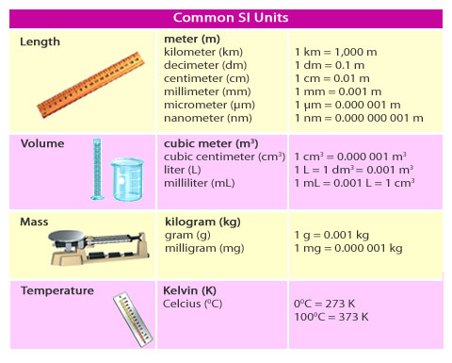

Slide 8
Fundamental Units in SI system
 | Quantity | Symbol | SI unit | Symbol
Main units | Length | L | metre | m
 | Mass | M | kilogramme | kg
 | Time | T | second | s
 | Electric Current | A | ampere | A
 | Thermodynamic Temperature | K | kelvin | K
 | Light Intensity | Cd | candela | cd
 | Amount of substance | mole | mole | mol
Supplementary units | Plane angle | dθ | radian | rad
 | Solid angle | dΩ | steradian | sr

Slide 9
Some Prefixes for Powers Used with “Metric” (SI and cgs) Units
Power | Prefix | Abbreviation
10¹⁸ | Exa | E
10¹⁵ | Peta | P
10¹² | Tera or Viga | T or V
10⁹ | Giga | G
10⁶ | Mega | M
10³ | Kilo | k
10¹ | Deca | da
10⁰ =1 | xxxxxxxx
10⁻¹ | deci | d
10⁻² | centi | c
10⁻³ | milli | m
10⁻⁶ | micro | µ
10⁻⁹ | nano | n
10⁻¹² | pico | p
10⁻¹⁵ | femto | f
10⁻¹⁸ | atto | a

Slide 10
DIMENSIONAL ANALYSIS
In physics, the word dimension denotes the physical nature of a quantity.
The symbols that we use in this section to specify the dimensions of length L , mass M, and time T.
In 1960, an international committee agreed on a standard system of units for the fundamental quantities of science, called SI
(Système International). Its units of length (meter), mass (kilogram) and time are the meter (second):(mks units).
For example, The distance between two points, can be measured in feet and meters.

Slide 11
Standard system of units for the fundamental quantities of science, called SI (Système International). Its units of length (meter), mass (kilogram) and time are the meter (second):(mks units).
Quantity | Abbreviation | Unit
Length or Distance | Ɩ, x, d, r, h | m
Mass | m | kg
time | t | s
Force | F= mg | Newton | kg m/s²
Capacitance | C | Farad
Charge | Q, q | Coulomb
Temperature | T | ºC, ºK, ºF
Energy | K (KE), U (PE) | Joule | kg m²/s²

Slide 12
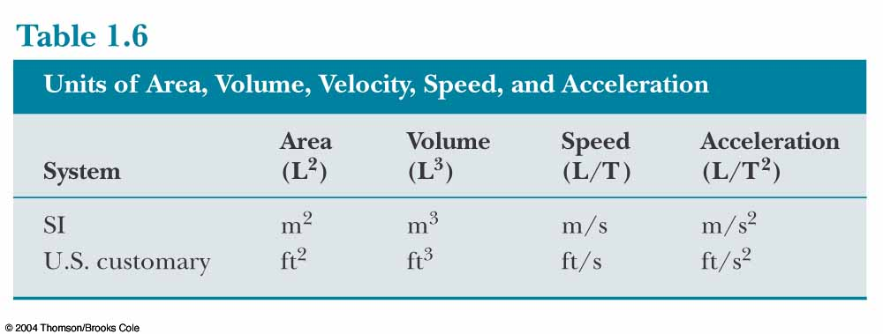

Slide 13
Dimensional formulae for some physical quantities
 | Physical quantity | Symbol | Formula | Dimensional formula | Unit
General | Length | L | Fundamental | [M⁰LT⁰] | m
 | Mass | M | Fundamental | [ML⁰T⁰] | kg
 | Time | T | Fundamental | [M⁰L⁰T] | s
 | Area | A | Length x breadth | [M⁰L²T⁰] | m²
 | Volume | V | Length x breadth x height | [M⁰L³T⁰] | m³
 | Linear density |  | Mass / length | [ML^{–1}T⁰] | kg m^{–1}
 | Mass Density | ρ | Mass / volume | [ML^{–3}T⁰] | Kg m^{–3}
 | Specific gravity or relative density | RD | Density of the substance / density of water | [MºLºTº] | ––
 | Specific volume |  | 1 / density | [M^{–1}L³T⁰] | kg^{–1} m³
 | Time period | T | Time taken for 1 oscillation | [M⁰L⁰T] | s
 | Frequency | ν | 1 / time period | [M⁰L⁰T^{–1}] | Hz or s⁻¹

Slide 14
Mechanics | Distance, displacement, wavelength, focal length | s, λ, f |  | [M⁰LT⁰] | m
 | Speed | v | Distance / time | [M⁰LT^{–1}] | m s^{–1}
 | Velocity | v | Displacement / time | [M⁰LT^{–1}] | m s^{–1}
 | Velocity gradient |  | dv / dx | [M⁰L⁰T^{–1}] | s^{–1}
 | Acceleration or acceleration due to gravity | a or g | Velocity / time | [M⁰LT^{–2}] | m s^{–2}
 | Momentum | p | Mass x velocity | [MLT^{–1}] | kg m s^{–1}
 | Force | F | Mass x acceleration | [MLT^{–2}] | kg m s^{–2} or newton (N)
 | Force constant or spring constant | K | Force / extension | [ML⁰T^{–2}] | N m^{–1}
 | Impulse | j | Force x time | [MLT^{–1}] | N s or kg m s^{–1}

Slide 15
Mechanics | Work | W | Force x Displacement | [ML²T^{–2}] | kg m²s^{–2} or joule (J)
 | Energy | E | Capacity to do work | [ML²T^{–2}] | joule (J)
 | Energy density |  | Energy / volume | [ML^{–1}T^{–2}] | J m^{–3}
 | Power | P | (Work or energy) / time | [ML²T^{–3}] | J s^{–1} or Watt (W)
 | Pressure | P | Force / area | [ML^{–1}T^{–2}] | N m^{–2} or Pascal (Pa)
 | Pressure head |  |  | [MºLTº] | m
Gravitation | Gravitational potential |  | G P E / mass | [M⁰L²T^{–2}] | J kg^{–1}
 | Universal gravitational constant | G | G = F d²/(m₁m₂) | [M^{–1}L³T^{–2}] | N m² kg^{–2}
 | Intensity of gravitational field |  | F / m | [M⁰L¹T^{–2}] | N kg^{–1}

Slide 16


Volume of
(Cube of side L) = L³
(Sphere of Radius r) =
(Cylinder of Radius L and Height H)
=

Slide 17
الكثافة
في الكميات الصغيرة من المائع يمكن كتابة الصيغة الرياضية في الصورة التالية:
وحدة قياس الكثافة

Slide 18
الضغط
هو القوة المؤثرة على وحدة المساحة من المائع، وهو كمية قياسية
القوة
الضغط
المساحة

Slide 19
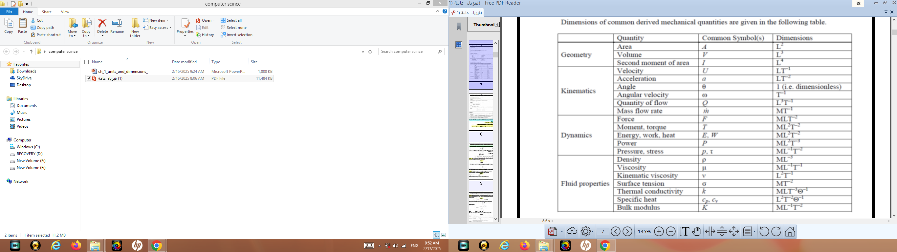

Slide 20
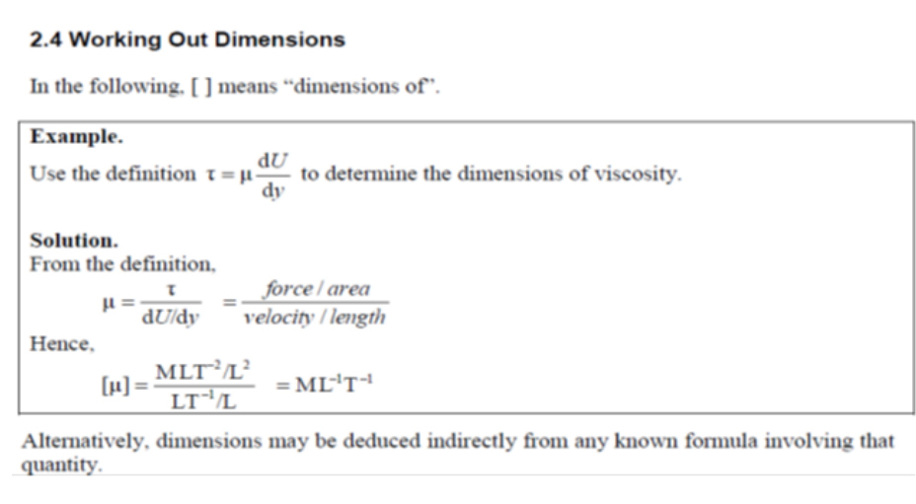

Slide 21
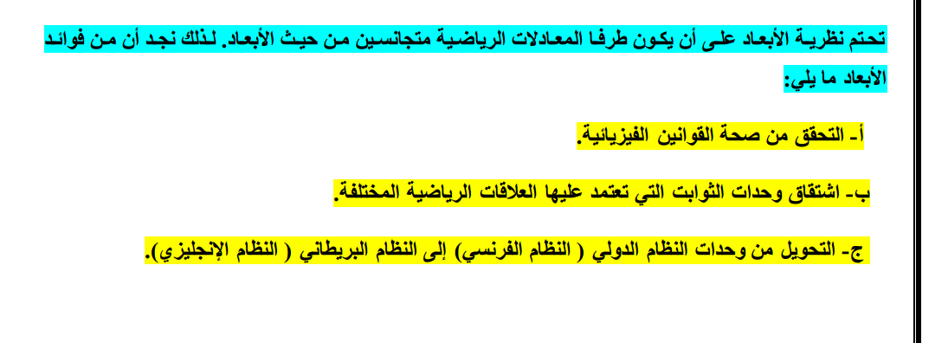
نظرية الأبعاد و تطبيقاتها:

Slide 22
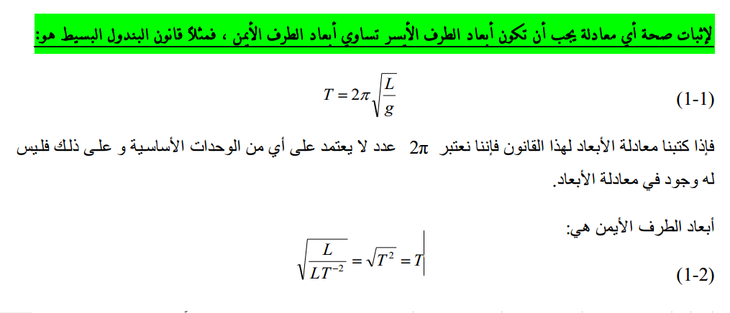

Slide 23
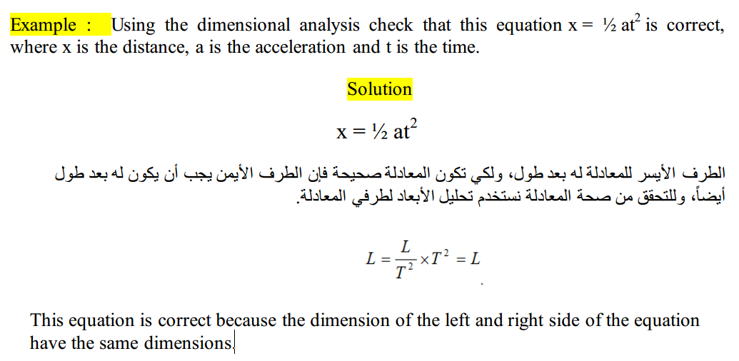

Slide 24
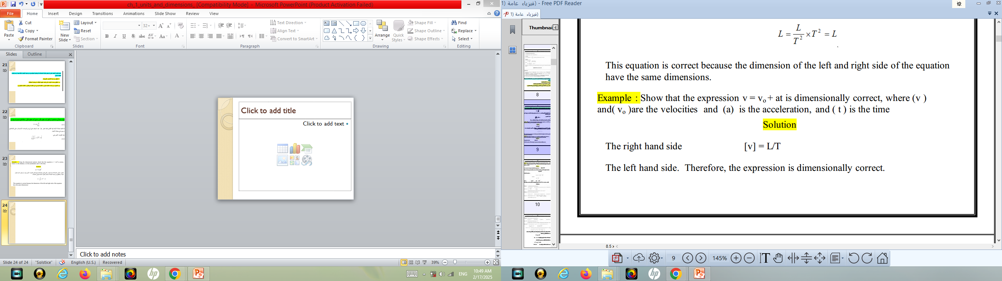

Slide 25
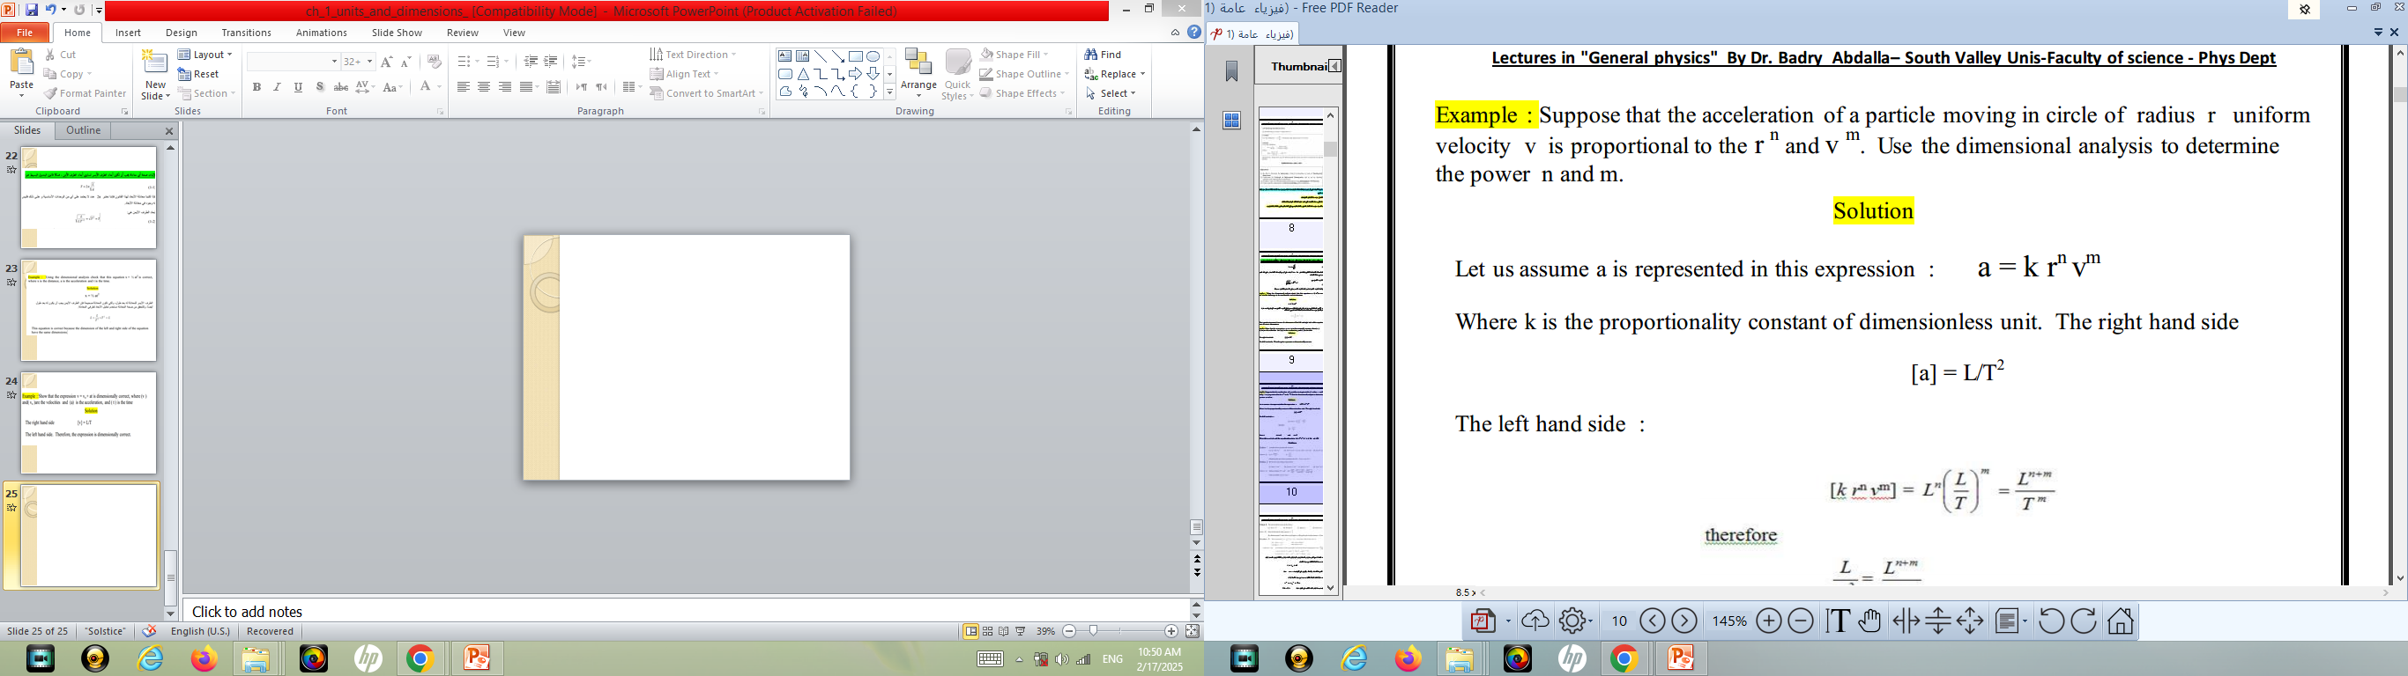

Slide 26
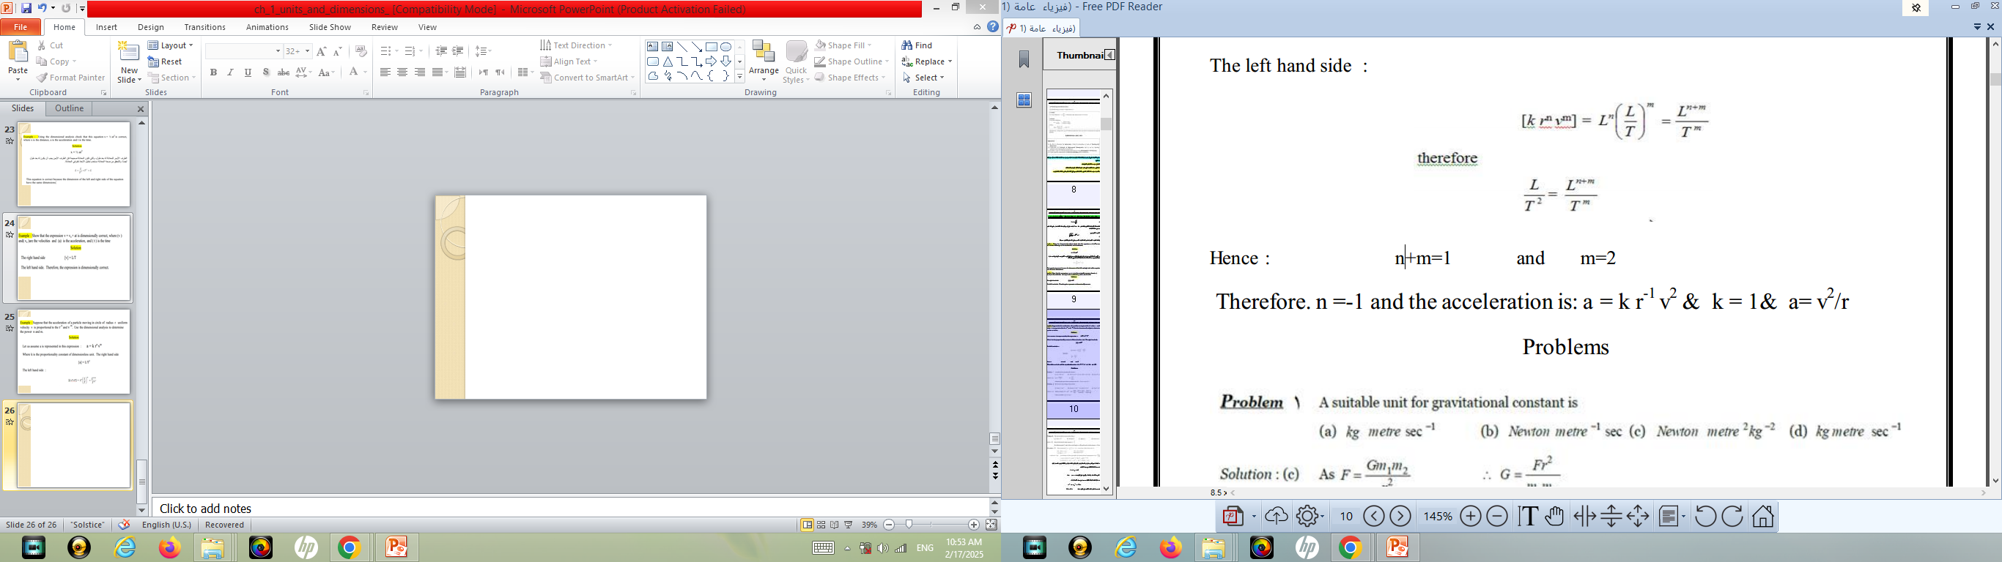

Slide 27
Oscillations
Periodic & Oscillatory Motion:
The motion in which repeats after a regular interval of time is called periodic motion.
1. The periodic motion in which there is existence of a restoring force and the body moves along the same path to and fro about a definite point called equilibrium position/mean position, is called oscillatory motion.
2. In all type of oscillatory motion one thing is common i.e each body performing oscillatory motion) is subjected to a restoring force that Increases with increase in displacement from mean position.

Slide 28
Types of oscillatory motion
It is of two types such as linear oscillation and circular oscillation.
Example of linear oscillation:-
1. Oscillation of mass spring system.
2. Oscillation of fluid column in a U-tube.
3. Oscillation of floating cylinder.
4. Oscillation of body dropped in a tunnel along earth diameter.
5. Oscillation of strings of musical instruments

Slide 29
Example of circular oscillation
1. Oscillation of simple pendulum.
2. Oscillation of solid sphere in a cylinder (If solid sphere rolls without slipping).
3. Oscillation of a circular ring suspended on a nail.
4. Oscillation of balance wheel of a clock.
5. Rotation of the earth around the sun.

Slide 30
Oscillatory system
The system in which the object exhibit to & fro motion about the equilibrium position with a restoring force is called oscillatory system.
2. Oscillatory system is of two types such as mechanical and non- mechanical
system.

Slide 31
Non-mechanical oscillatory system
In this type of system, body itself doesn't change its position but its physical property varies periodically.
e.g.:The electric current in an oscillatory circuit, the lamp of a body which is heated and cooled periodically, the pressure in a gas through a medium in which sound propagates, the electric and magnetic waves propagates undergoes oscillatory change.

